Slide 1
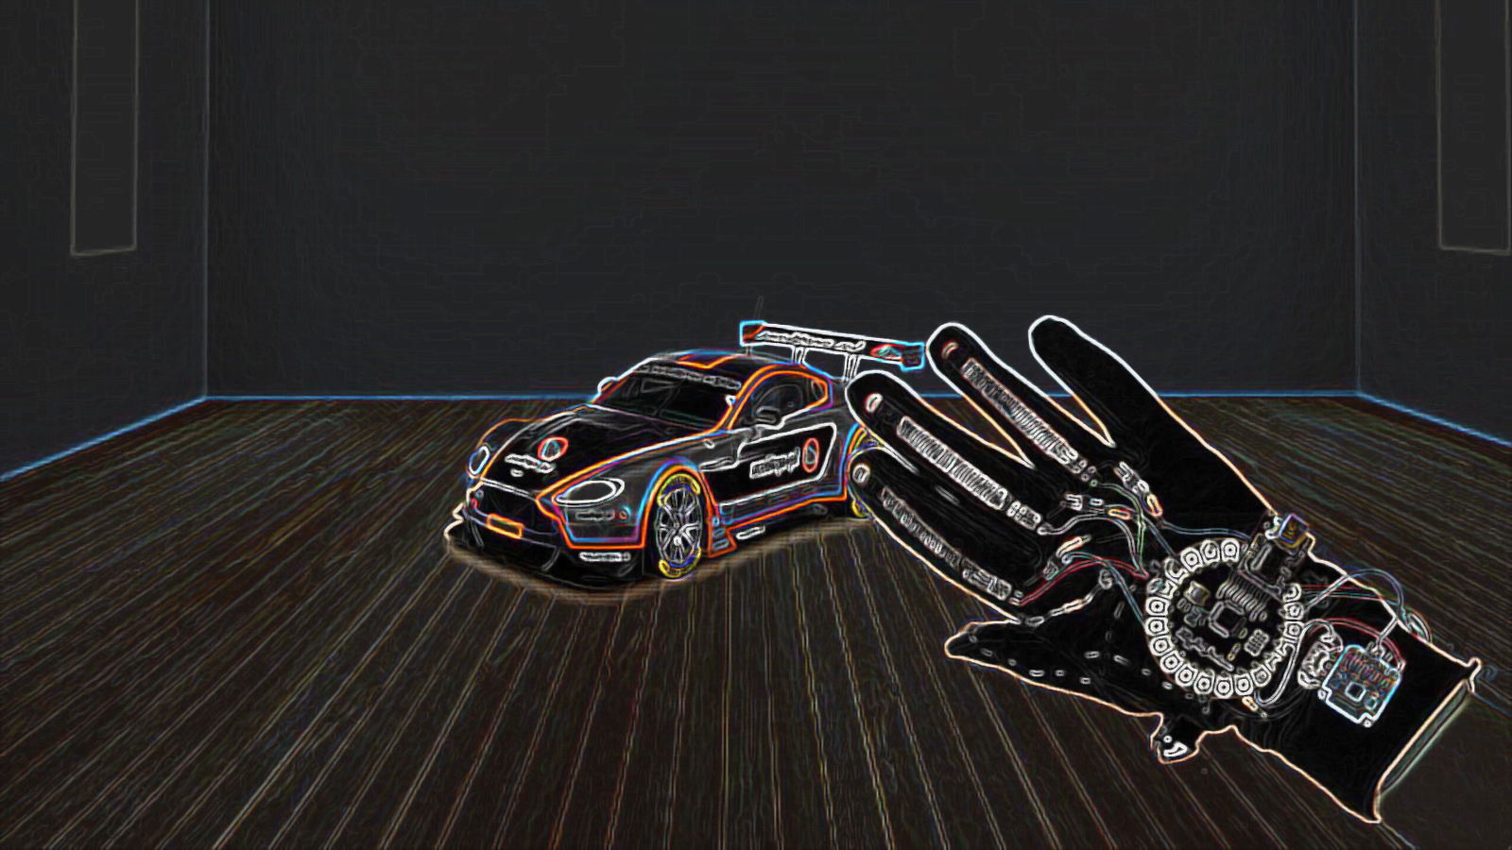

Controlling car with hand motion

Slide 2

Introduction
This project aims to control a car direction and speed using hand motion or finger motion.
It’s divided into two main modules (Car module and hand glove module).

Slide 3
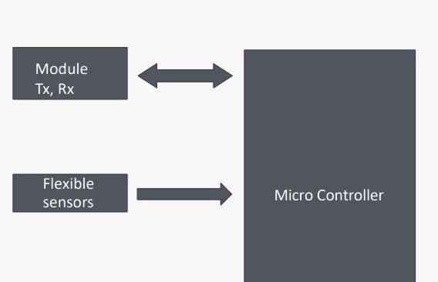
Hand Module

Slide 4
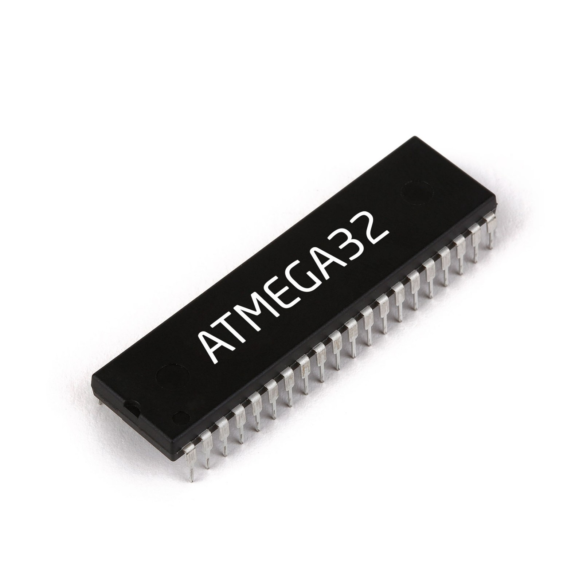
Microcontroller(atmega32)
is a small computer on a single integrated circuit containing a processor core, memory, and programmable input/output peripherals..
The avr microcontroller is based on the advanced reduced instruction set computer (risc) architecture.
Avr microcontroller can execute 1 million of instructions per second if cycle frequency is 1mhz provided by crystal oscillator.
We will use this microcontroller in Hand glove module and car module.

Slide 5
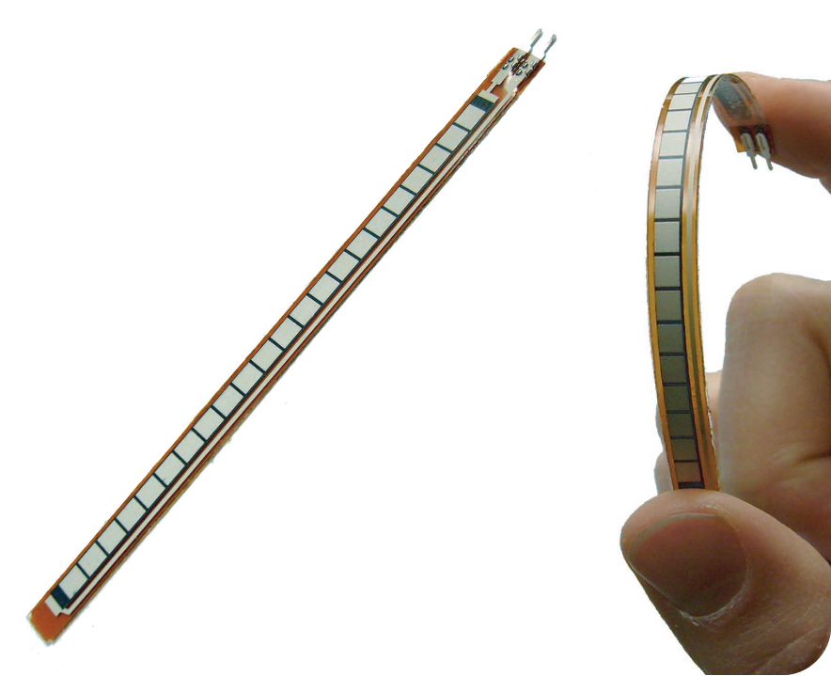
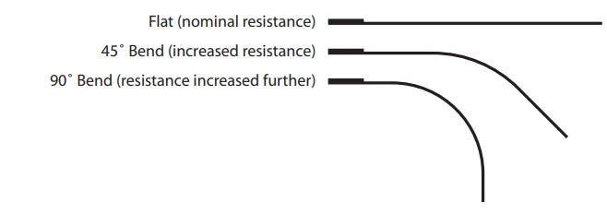
Flex Sensor
It’s used to detect bending motion by changing its resistance depending on the amount of bend on the sensor.
Resistance range: 45k to 125k ohms
It’s used to detect any motion of fingers, every finger must have an individually one.
According to the position of back fingers, the relative motion of motors will be sent to the module of car.
Thumb posture controls the speed of motors.

Slide 6
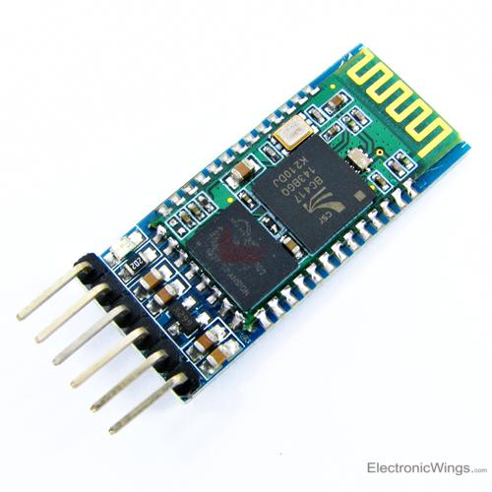
HC-05 BLUTOOTH MODULE
HC-05 IS A BLUTOOTH MODULE WHICH IS DESIGNED FOR WIRELESS COMMUNICATION.
THIS MODULE CAN BE USED IN A MASTER OR SLAVE CONFIGURATION.
IT USES SERIAL COMMUNICATION TO COMMUNICATE WITH DEVICES.
IT COMMUNICATES WITH MICROCONTROLLER USING SERIAL PORT (USART).
We will use this blutooth module in hand glove module and car module.

Slide 7
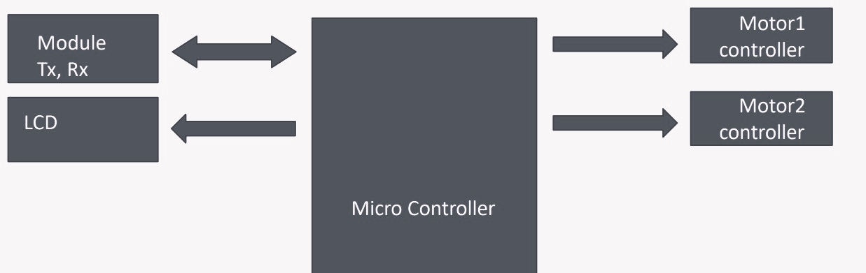
Car Module

Slide 8
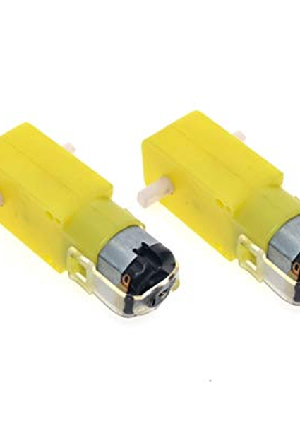
DC Motors.
A DC MOTOR IS ANY OF A CLASS OF ROTARY ELECTRICAL MOTORS THAT CONVERTS DIRECT CURRENT ELECTRICAL ENERGY INTO MECHANICAL ENERGY. THE MOST COMMON TYPES RELY ON THE FORCES PRODUCED BY MAGNETIC FIELDS.

Slide 9
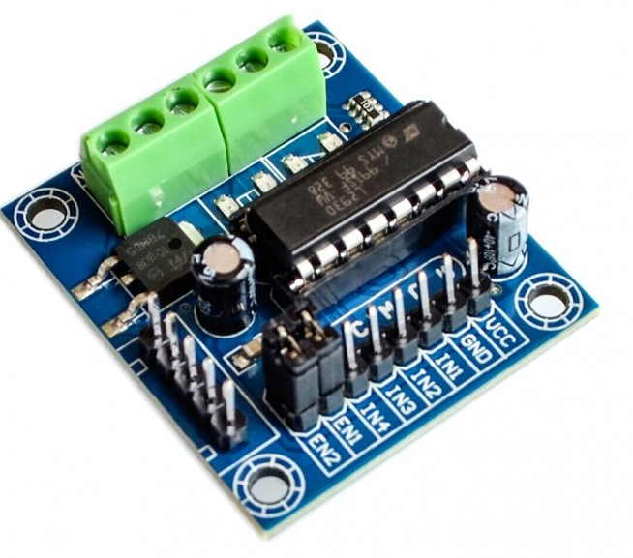
L293D.
It’s a dual h-bridge motor driver, so with one ic(integrated circuit) we can interface two dc motors which can be controlled in both clockwise and counter clockwise direction.
using PWM (pulse – width – modulation) by changing its duty cycle to control speed and other 2 pins for the direction.

Slide 10
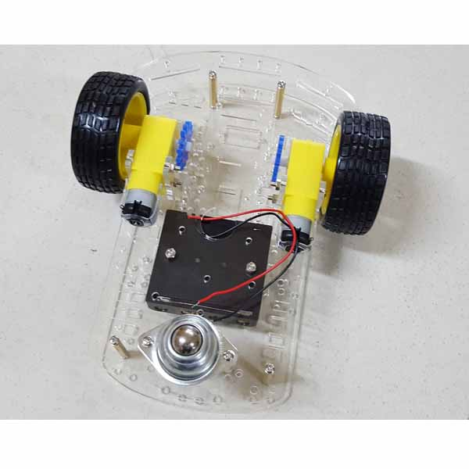
chassis + caster wheels + motors

Slide 11
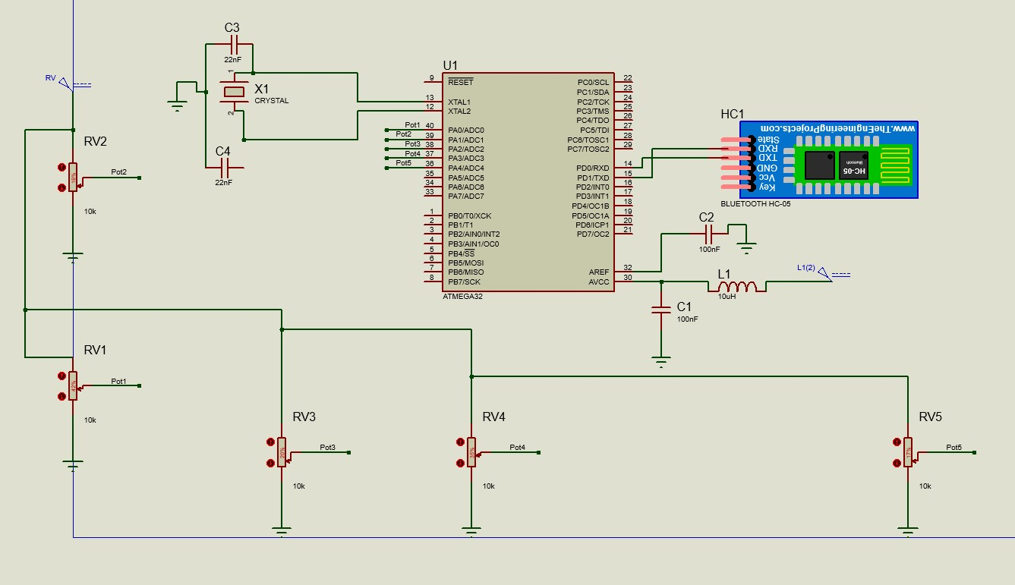
HAND MODULE IN SIMULATION USING PROTEUS.

Slide 13
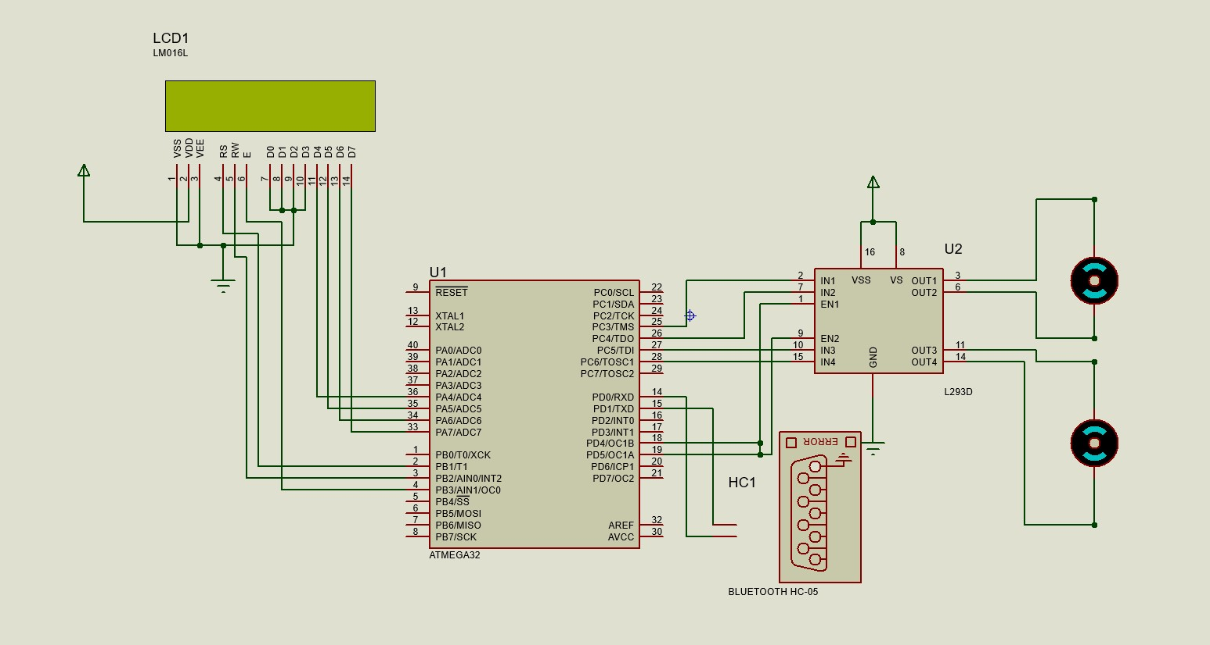
CAR MODULE IN SIMULATION USING PROTEUS

Slide 15
How the hand glove module and car module works together !
AS we previously explained that we use flexible sensor to translate finger motion to a corresponding resistance value that will be inserted in an electrical circuit and by using voltage divider we get certain output voltage to every corresponding resistance of the flexible sensor as we bent or unbent the finger .
The output voltage of the electrical circuit will be the input of the adc in our kit in hand glove module so that it converts the analog signal to a digital signal that we will be able to process our system based on this input.
We will define certain range of values that will correspond to a certain character that will be sent to the motor in the car module to perform certain movement (RIGHT – LEFT – FORWARD – BACKWARD ) And will provide characters sent to the car module to control speed of the motors.
The blutooth module will send these data from hand glove module (master) to car module (slave)
In the car module the movements that will be performed depends on the data received from the hand glove module.
Movement of the two motors is controlled by the Motor driver
Speed control is done using PWM (pulse – width – modulation) by changing its duty cycle to control speed and other 2 pins for the direction.

Slide 16

Thank you!

